Slide 1
Category review: Chips
June 2020
Retail Analytics
Brand note: If client logo is not required, use alternate title page layout right click slide thumbnail > Layout > Title

Slide 2
Notes:
To view Privacy video explaining how important data privacy is to Quantium, please click here: https://www.youtube.com/watch?v=Zq1QDAkoRzU
or here Q:\Company Reference\Brand & Design\Brand videos\Q Privacy.mp4
At Quantium, we believe that data is the behavioural footprint of humanity and that it has to be treated with the utmost care and responsibility.
Histories, attitudes, indeed lives are stored within it in ways that aren’t always apparent – and that’s what makes its potential so powerful.
To work with it responsibly, sensitively, we set ourselves the highest data privacy protection and governance standards.
We have spent 17 years perfecting privacy-by-design and secure-by-design principles. Central to this is not holding any personally identifiable information about people –
we neither receive it, and put the necessary protections in place to be unable to decipher it.
Every aspect of handling data is safeguarded: from its de-identification, to its encryption – data security is paramount and of the highest grade.
We pride ourselves on gaining the trust of iconic organisations around the world through years of securely working with their data,
and in turn the trust that builds with their stakeholders.

Slide 3
Executive summary
01
Chips Category Review
Most sold chips brand are (Kettle,Smiths,Doritos). Least sold chips brand are (French,Burger,Cheetos).
Mainstream Customers are more in number,compared to other Customers and Retirees are more in number, compared to other lifestaged customers.
sales are highest for (Budget, OLDER FAMILIES), (Mainstream, YOUNG SINGLES/COUPLES) and (Mainstream, RETIREES)
Mainstream customers did more sales when compared to others
Older singles/couples did more sales when compared to other lifestage.
02
Store Analysis
The results for trial stores 77 and 88 during the trial period show a significant difference in at least two of the three trial months.
This is not the case for trial store 86. We can check with the client if the implementation of the trial was different in trial store 86 but overall, the trial shows a significant increase in sales.

Slide 4
01
Category

Slide 5
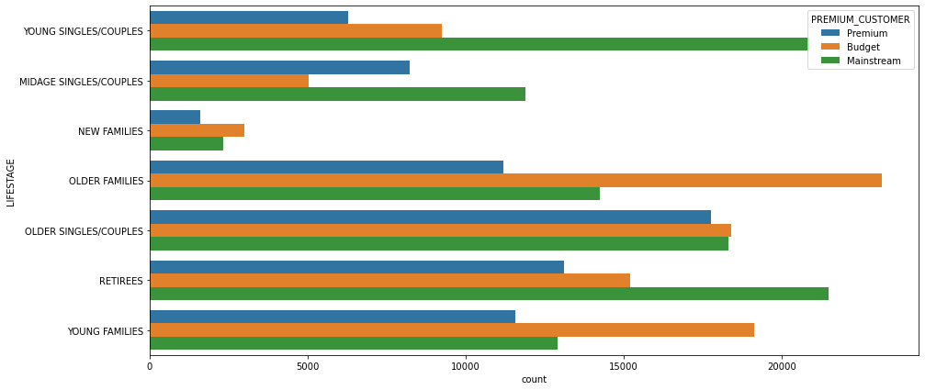
Sales are done more by Budget- Older Families, followed by Mainstream- Young singles/couples and Mainstream- Retirees.
Mainstream customers did more sales compared to others.

Slide 6
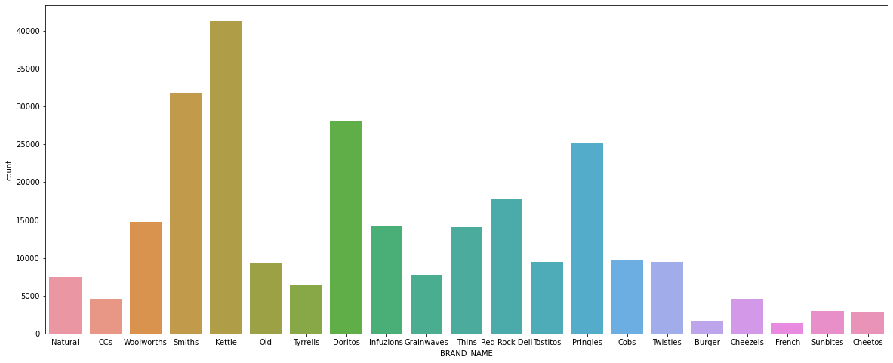
Most Sold Chips Brands are Kettle,Smiths and Doritos order by it’s quantity.

Slide 7
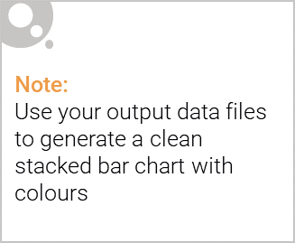
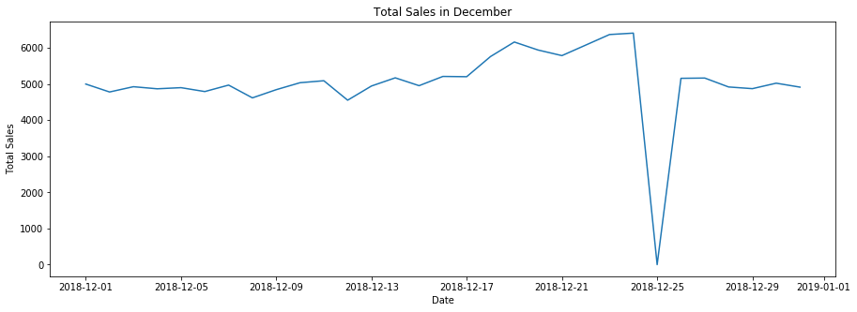
Editable (delete this)
The day with no transaction is a Christmas that is when the store is closed. But the sales were high on 24th of December, as many tend to buy stuff for christmas.
Sales increase steadily after Christmas as Newyear to about to come.

Slide 8
02
Trial store performance

Slide 9
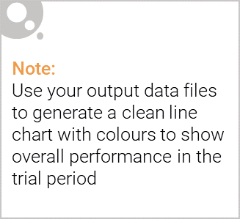
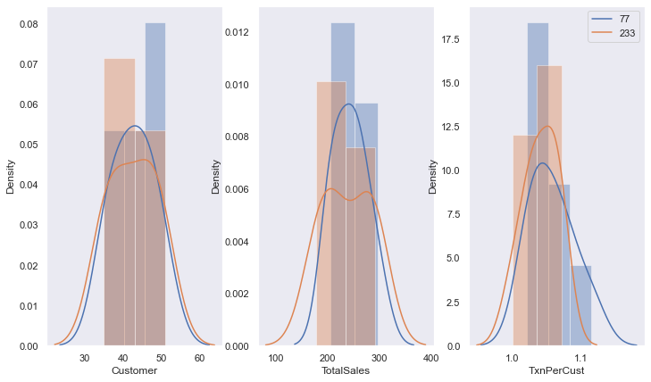
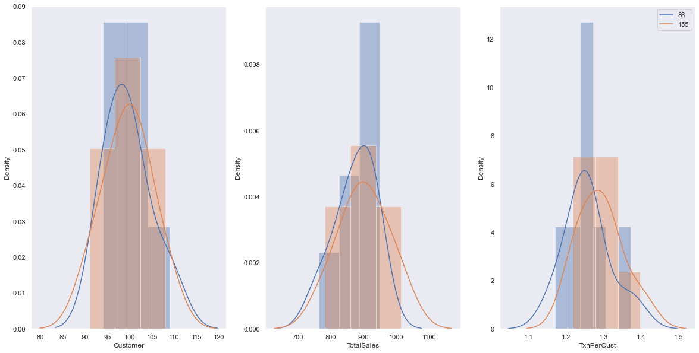
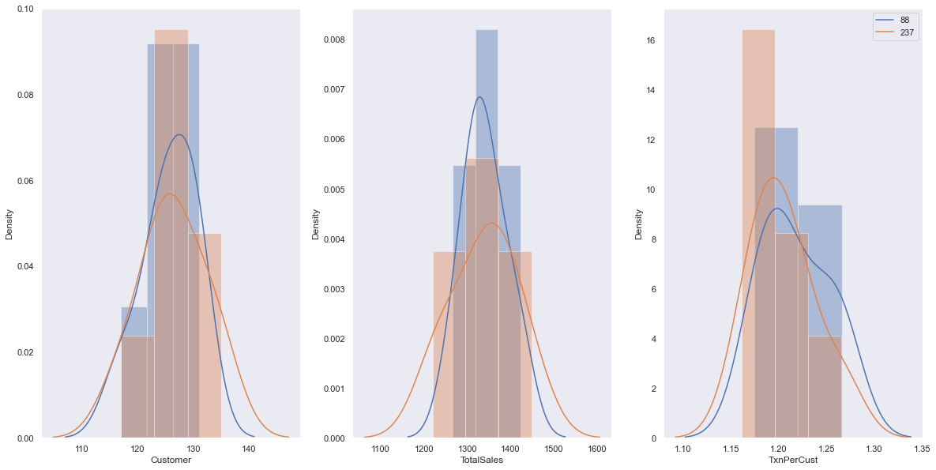
Explanation of the stores (77,233), (86,155), (88,237)

Slide 10
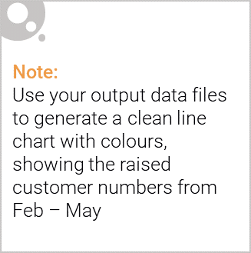
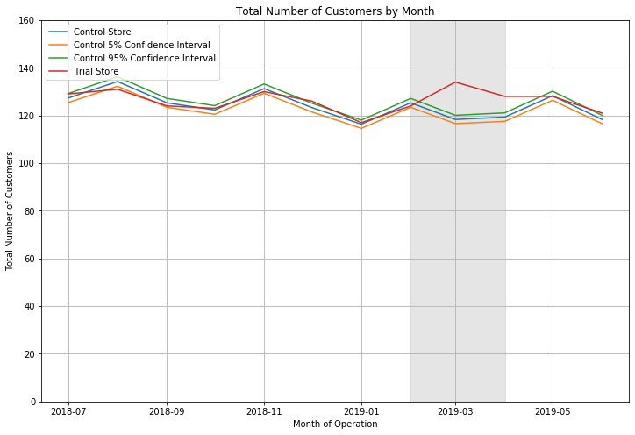
Total number of customers in the trial period for the trial store is significantly higher than the control store for two out of three months, which indicates a positive trial effect.

